Slide 1
Recommending Music via Textual Reviews
Michael Cantrell, PhD
Notes:
Hi guys, my name is Mike Cantrell and I’ll be telling you about making music recommendations using textual reviews.

Slide 2









Idea
Text may reveal nuance that 5 star ratings and up/down votes do not
Notes:
There are a lot of music services out there. My service is different in that it leverages the nuance of text.

Slide 3
Recommendation based on: Smashing Pumpkins
Spotify | Pandora | Amazon | My Recommender
Smashing Pumpkins | Nirvana | Smashing Pumpkins | Radiohead
Audio Slave | Mazzy Star | Smashing Pumpkins | Muse
Deftones | Nirvana | Smashing Pumpkins | Tori Amos
Pearl Jam | Foo Fighters | Smashing Pumpkins | Counting Crows
Up/Down Votes
5 Star Ratings
Million Dollar Algorithm
Textual Reviews
Notes:
Here’s an example of how my recommender compares to Spotify, Pandora and Amazon based off of a Smashing Pumpkins album. If you know the artists, you’ll probably agree that my recommendations are more nuanced than Pandora’s and Amazon’s.

Slide 4








Data
Back End
Front End
170K reviews of 4,000 CDs
NLTK, NMF, pandas
Interactive Web App
1.5M sentences
J. McAuley, C. Targett, J. Shi, A. van den Hengel.
Notes:
My data consisted of about 170 thousand amazon.com reviews of CDs and Vinyl downloaded from these authors webpage. I used these tools for my analysis, and flask and heroku for my interactive web app.

Slide 5
Process
Natural Language Processing
Interactive Filter
Recommendation
Reviews
Collaborative
Filtering
Notes:
I built two recommenders in parallel. The collaborative filter is my take on the classic, predictable Amazon recommendation system, while the NLP recommender is text based and consequently more experimental. By adjusting the interactive filter, we control how experimental the final recommendations can be. By default, only NLP recommendations in the top 60% of the collaborative filter pass through. This 60% can be adjusted. Let’s zoom in on making the NLP recommender.

Slide 6
NLP Process
Count Vectorizer
Topic 1 | Topic 2 | Topic 3
0.8 | 0.15 | 0.05
Topic 1 | Topic 2 | Topic 3
0.32 | 0.06 | 0.02
Reviews
Sentence
NMF
0.4
Sentiment Analysis
Notes:
I analyzed the reviews on a sentence level. I used Count Vectorizer and NMF to put each sentence in to topics, and Sentiment Analysis to judge the positivity of the sentence. Averaging these scores over all sentences about a given album resulted in a score.

Slide 7
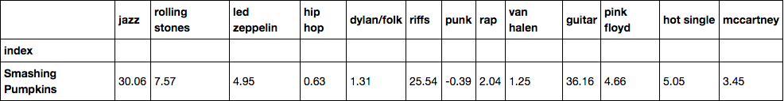
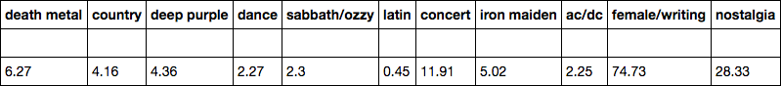
Example Album as Vector
Notes:
In this way, we have quantified what people say about each album. Here’s the vector corresponding to the Smashing Pumpkins album from earlier. I’ve hand labelled the topics by inspecting the top words in each topic. This album scored highest in the female/writing topic and guitar categories.

Slide 8
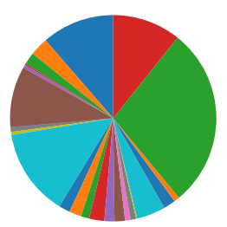
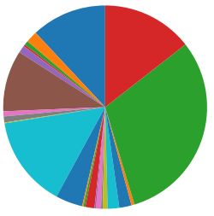
NLP Recommender
jazz
nostalgia
jazz
nostalgia
riffs
riffs
female/writing
female/writing
guitar
guitar
Smashing Pumpkins
Radiohead
Notes:
Once the albums are in the 20 odd dimensional space, it is easy to determine which albums are most similar. Here you see the Radiohead album which was recommended from the Pumpkins album earlier. The pie charts clearly point to the similarity of the albums. Moreover, now that we have transformed textual reviews in to vectors, we can do some cool stuff: given two albums, we can find their musical love child. Or, we can let a user describe the music she wants to hear in her own words, and then make her recommendations.

Slide 9
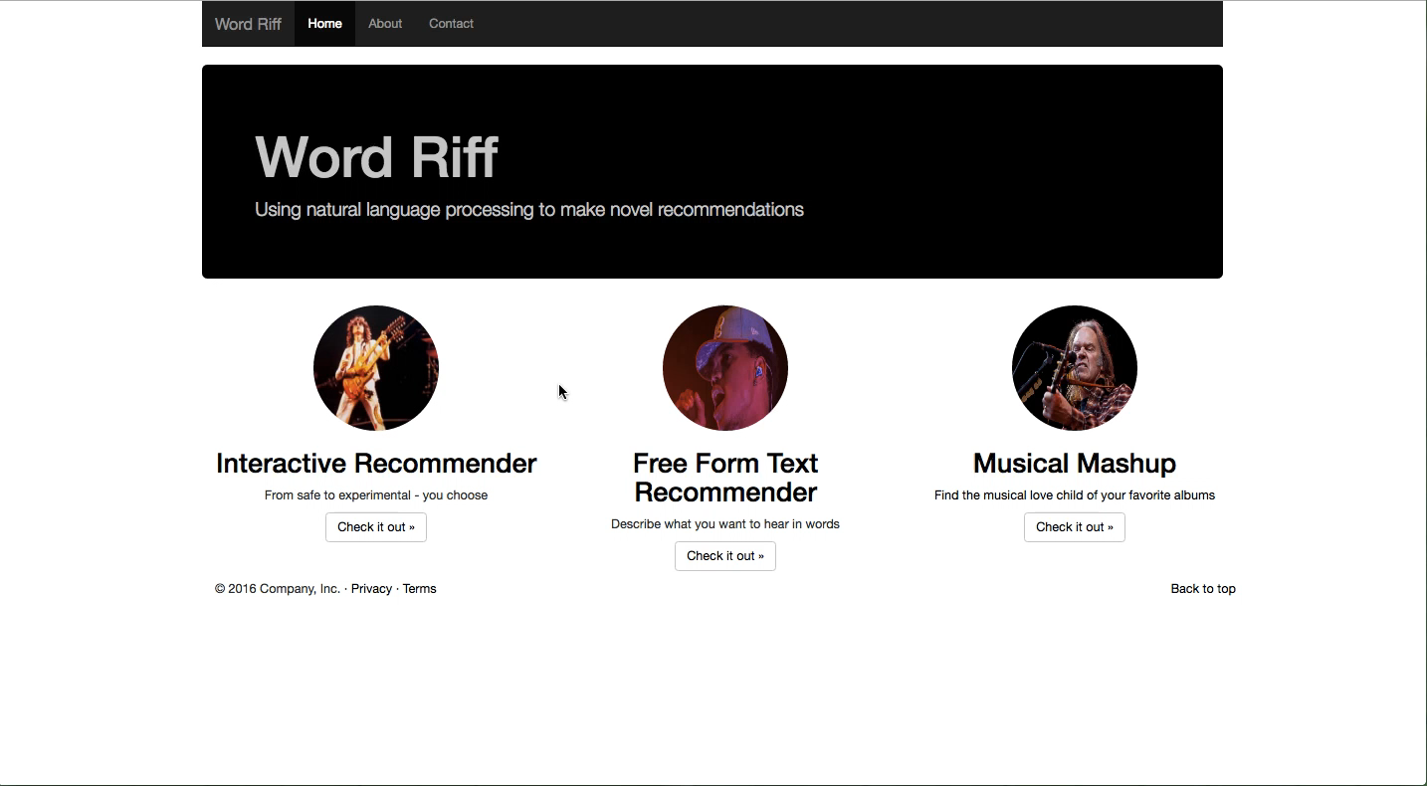

Slide 10
Play with the app: www.wordriff.pythonanywhere.com
Thanks!
Michael Cantrell, PhD
michaelaaroncantrell@gmail.com
https://github.com/michaelaaroncantrell

